Slide 1
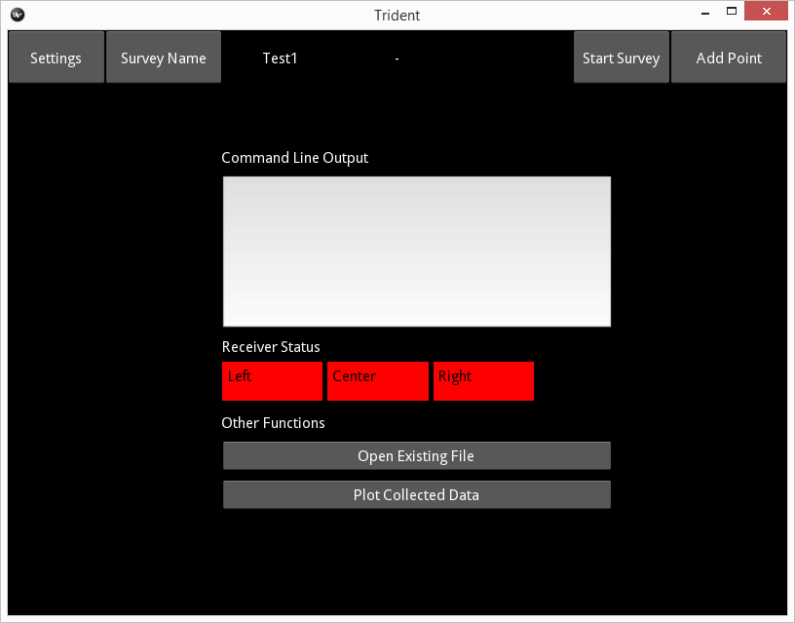
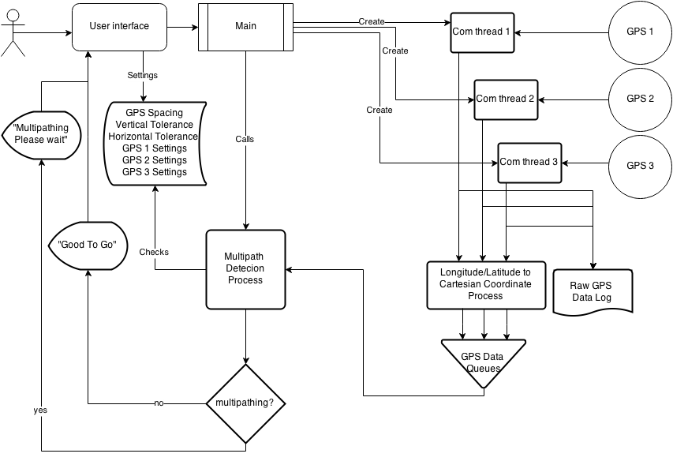
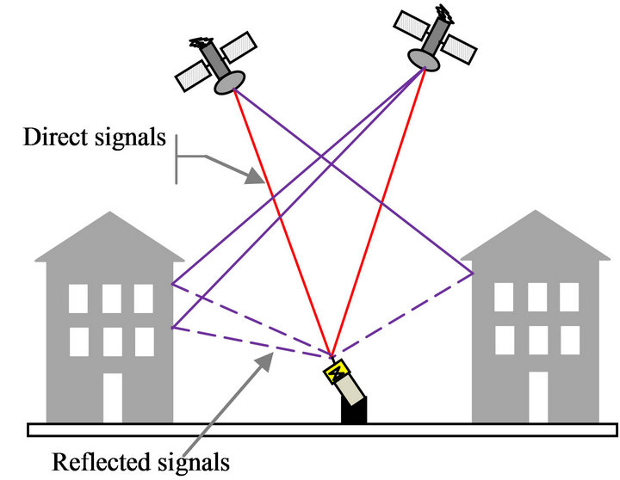
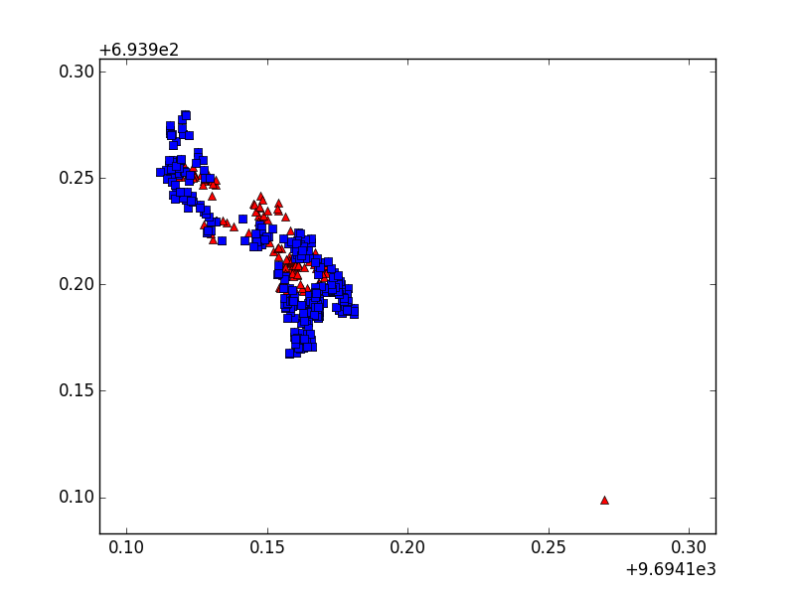
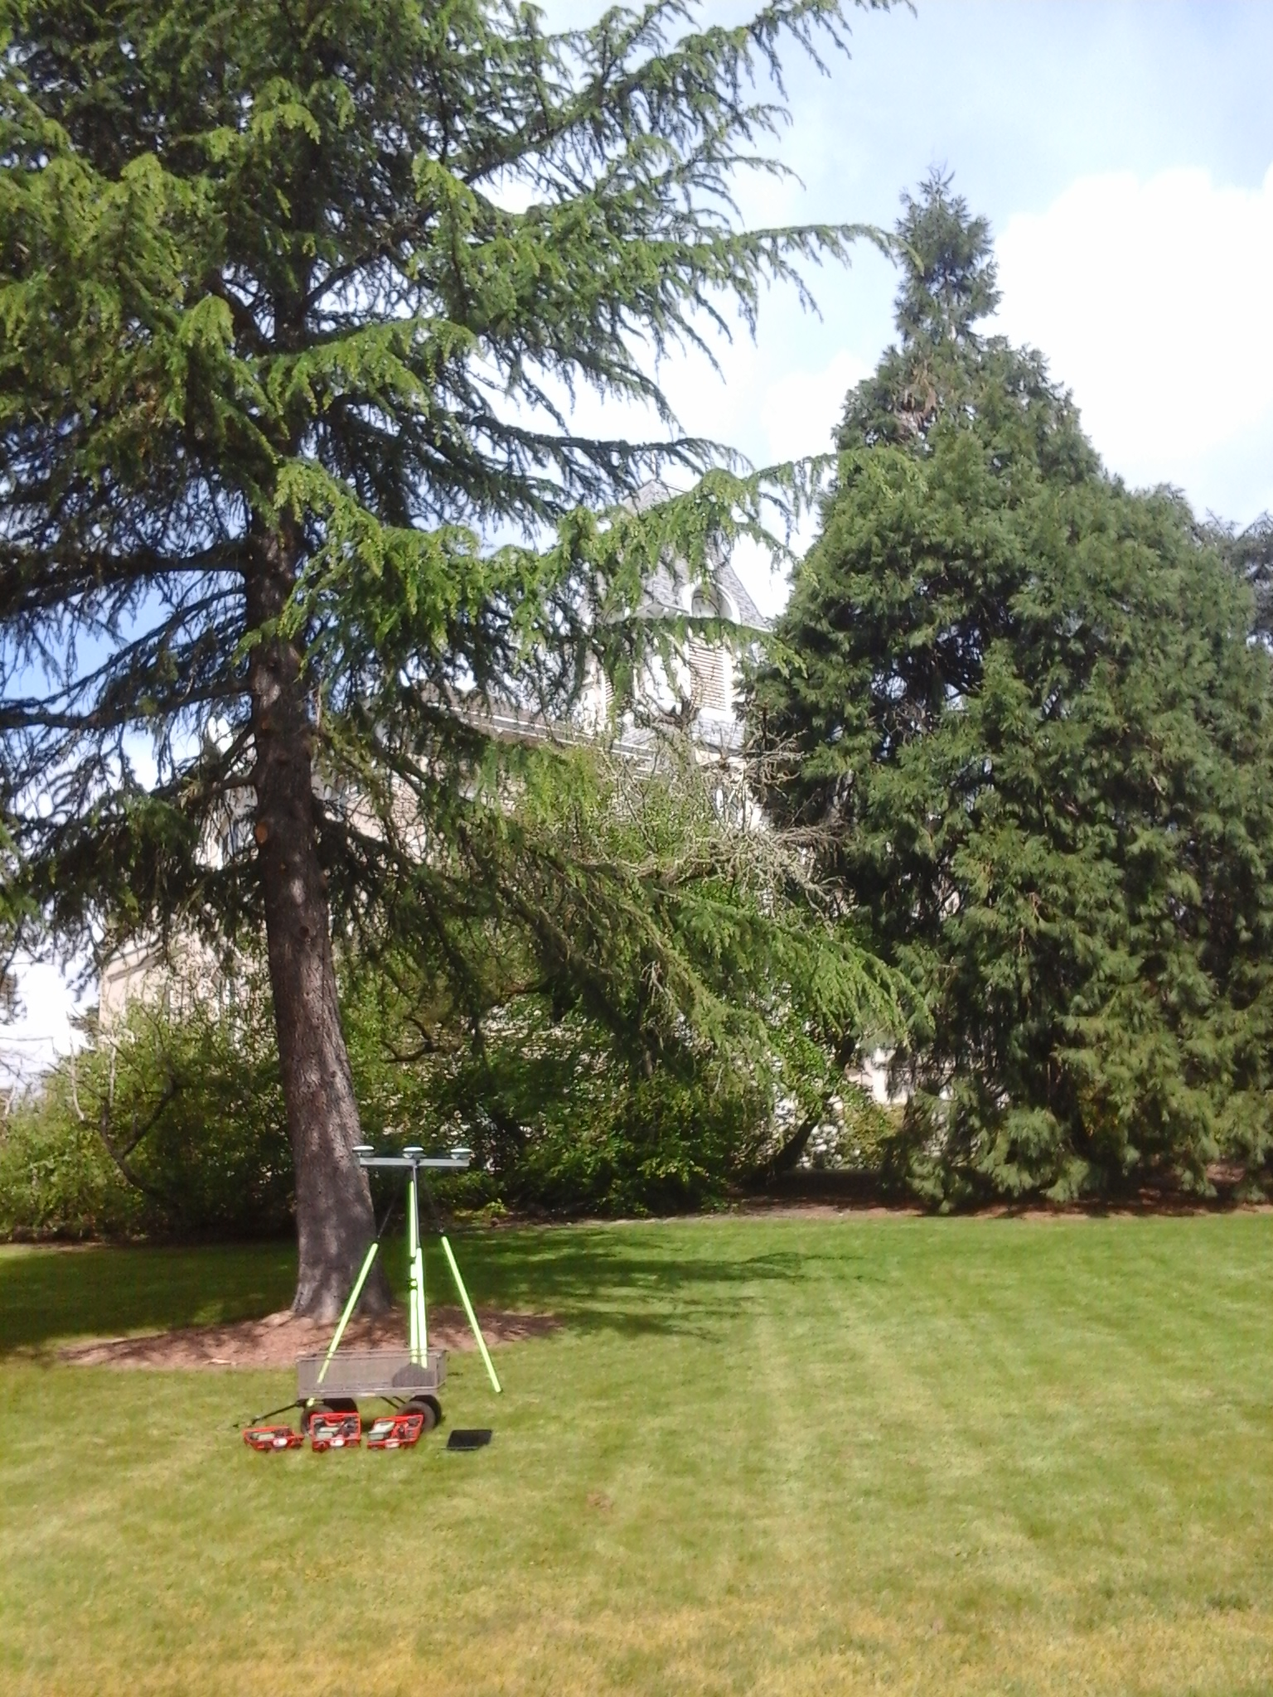
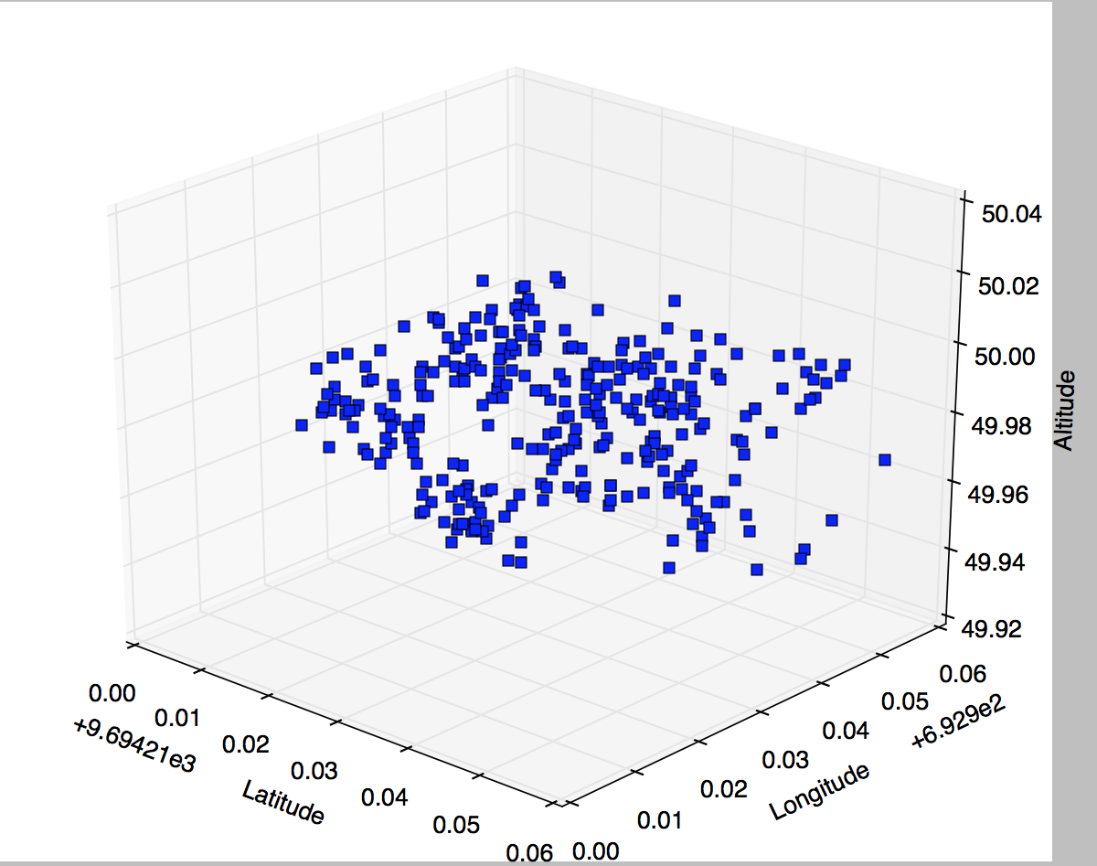
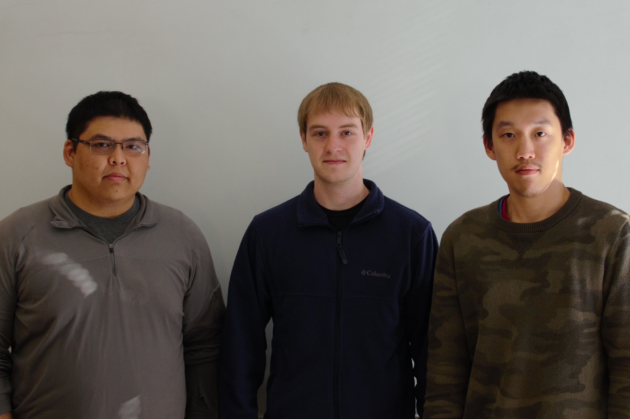
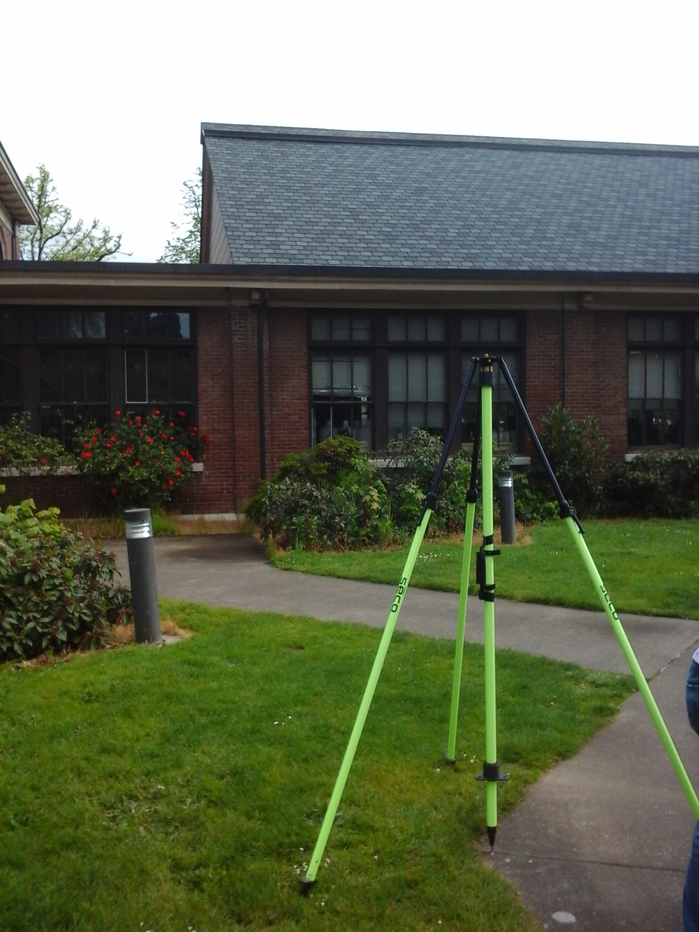
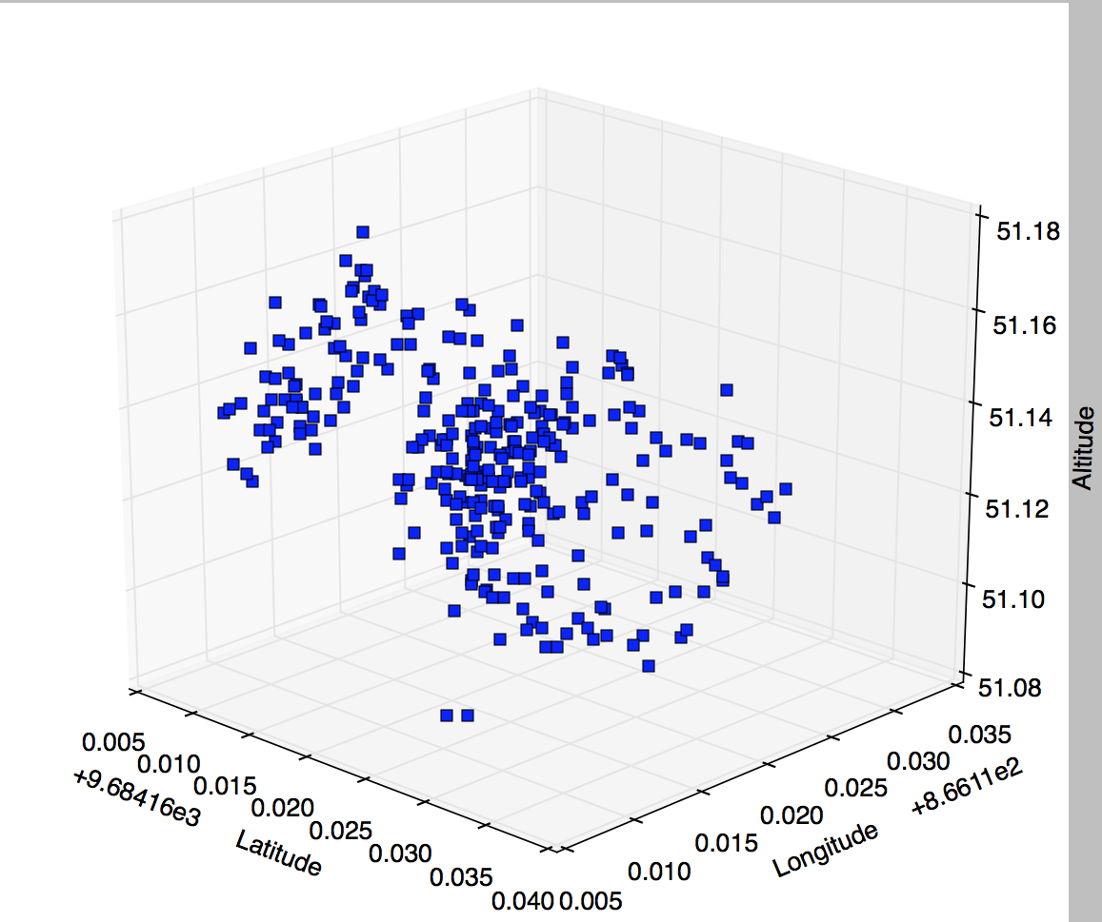
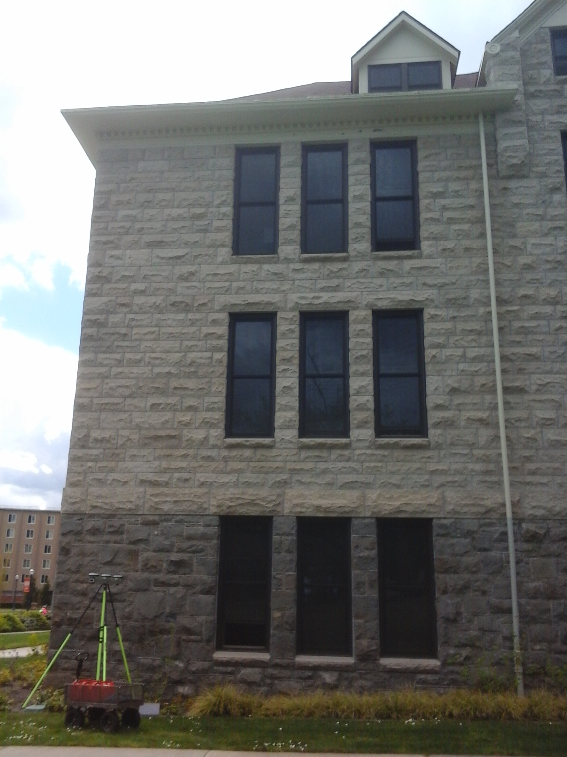
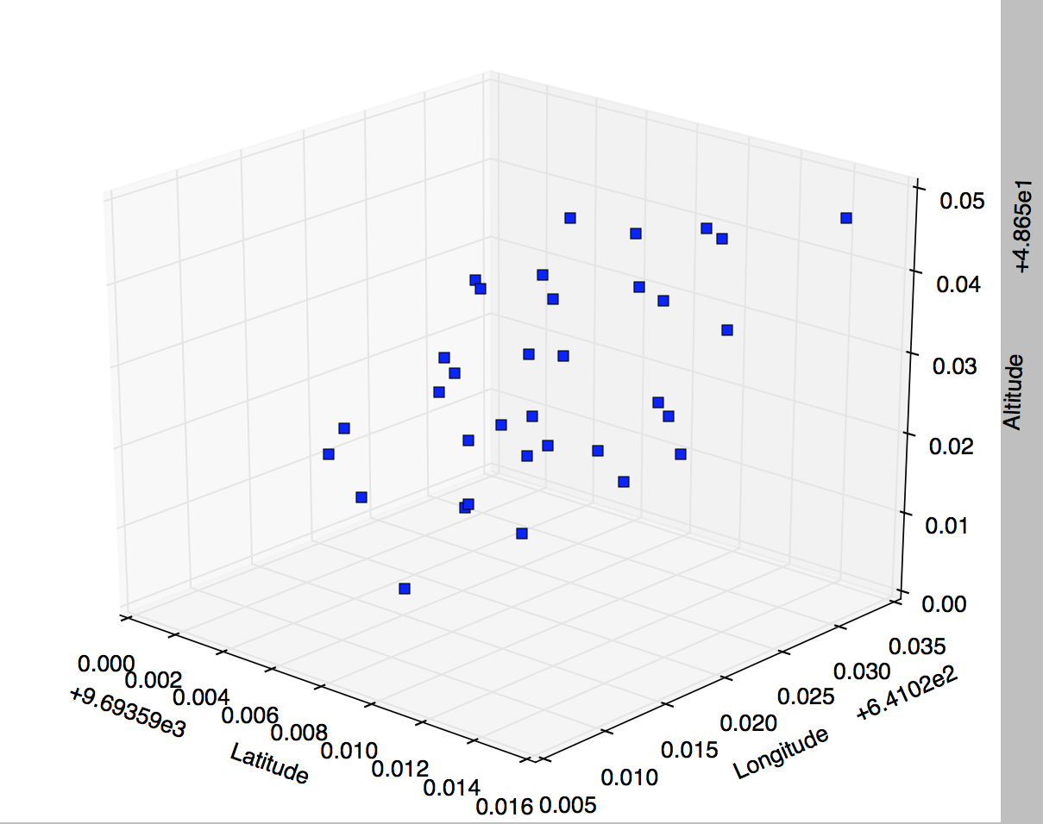
Trident : A Novel solution to Multi-pathing GPS signals
Abstract
Graphical User Interface
We developed an algorithm to increase the accuracy of GPS data collected near obstructions. The algorithm stacks data collected by three GPS units into separate queues. Then, for each data point in the queue, we check for multipathing by testing the data with various statistical tests. Finally, if the data meets the tests’ requirements, the data is marked as good and displayed to the user. We were able to field test the algorithm and collect accurate results.
Albert Le, Nathan Christopher, and Daniel Lin
Algorithm Flowchart
Background
Conclusion
Obstructions can reflect GPS signals away from the surveyors. This phenomenon is known as multipathing. This can decrease the quality of the data collected and produce inaccuracies.
Currently, if data contains multipathing, surveyors need to throw away the entire set of data and spend significant time recollecting data.
Currently, there are no existing methods that can detect, or filter multipathing.
The goal of this project is to solve the problem of multipathing.
Our algorithm is able to filter multipathing signals out of incoming gps data
Future works includes further testing of the algorithm to increase accuracy
More extensive field tests to get more feedback from surveyors
Our Client
Dr. Dan Gillins Ph.D., P.L.S.
Assistant Professor of Geomatics
School of Civil & Construction Engineering
Oregon State University
Dan.Gillins@oregonstate.edu
Results
Meet the team
Figure 4. Unanalyzed Data (Red) overlaid by analyzed Data (Blue)
Figure on the left is control point 2, where it contains a mixture of multipathing and non-multipathing signals. The number of clean data points we have in our graph is less than control point 1.
Figure 1: A visual representation of multipathing. When signals get reflected by obstructions such as buildings or trees, the distance travelled by the signal is much longer than the direct signal. This reflection of signal is called multipathing.
From left to right:
Albert Le Leal@onid.oregonstate.edu
Nathan Christopher Christon@onid.oregonstate.edu
Daniel Lin Lintzu@onid.oregonstate.edu
Figure on the left shows control point 1. This point is known to contain very little multipathing signals. Figure on the fight are non-multipathing signals detected by the algorithm.
Figure 3 is control point 3, where there are lots of multipathing signals and very little clean data. Our algorithm is able to filter out multiple multipathing signals, producing clean data.
Notes:
If tri-fold mounting at SMS – make sure no text or image is in-between the two vertical guide lines; this space will be cut away. To view the vertical guide lines: Select “View” from the main menu, select “Guides” from the pull down menu, and lastly select “Static Guides”.

